Slide 1
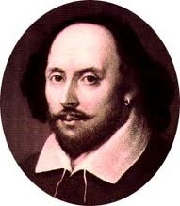
William Shakespeare
"HE WAS NOT OF AN AGE, BUT FOR ALL TIME!"
~ Ben Johnson
1564-1616

Slide 2
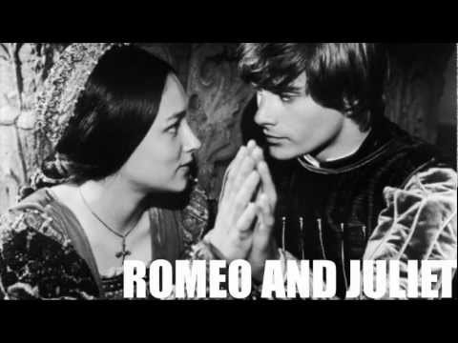

Slide 3
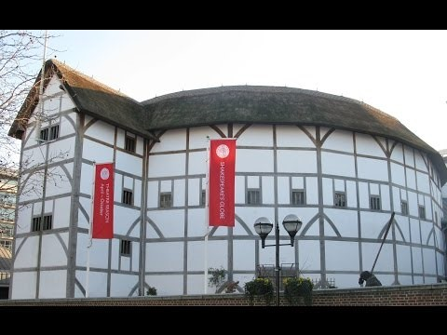

Slide 4
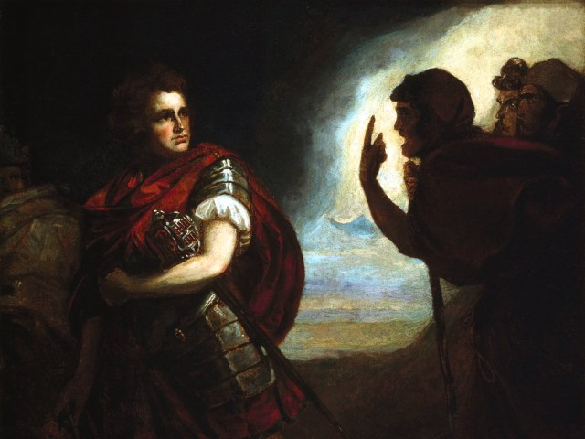
The Tragedy of Macbeth
Lesson 1-Background

Slide 5
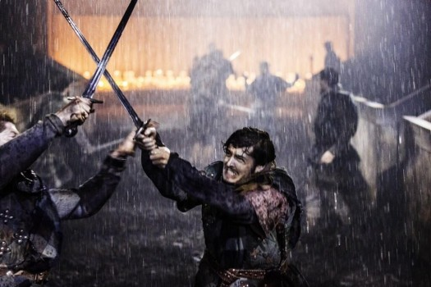
Activator-
Bad Luck?

Slide 6
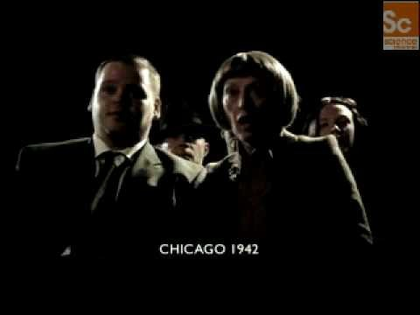

Slide 7
Simpsons Movie Clip
Click Here

Slide 8
Activity 1-
Background

Slide 9
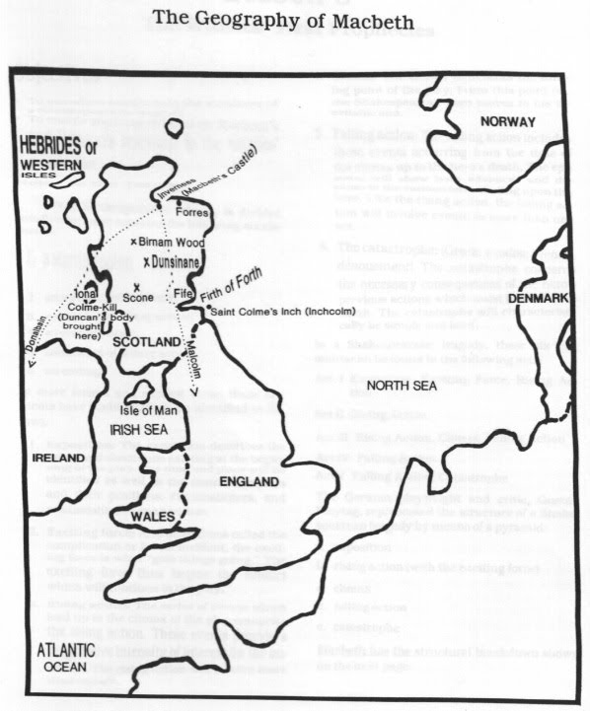

Slide 10
What you need to know first……
Macbeth is set in 1040 AD.
Macbeth was written for King James I of England.
Macbeth was a real Scottish king; however, very little of the play is a true account of his life.
Witchcraft plays a large role in Macbeth. People in this time period thought witches were real and that they often tried to corrupt people.
Macbeth is a tragedy. Playgoers knew that a tragedy meant that the play would not end well, but it would either teach them something about human nature or leave then questioning human nature.

Slide 11
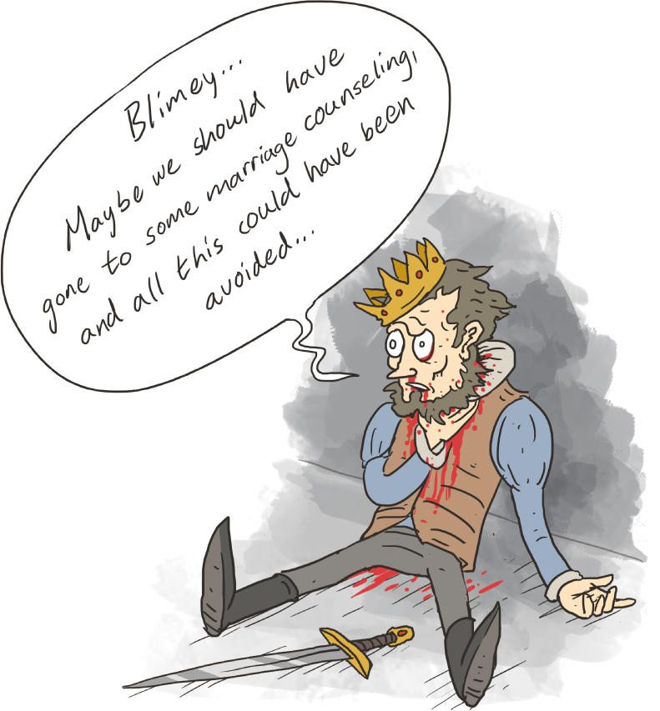
Major Themes
Power and Corruption
Destiny vs. Fate
The Power of Guilt

Slide 12
Why Macbeth and not MacBeth?
Since Macbeth was written for King James I Macbeth’s name was changed from having a capital B to a lowercase B. This showed that Macbeth was Christian. Scottish Christians changed the capitalization in their name to show their new religion.
Why does this matter to us?
Well, Macbeth is a God-fearing Christian, meaning that he is very afraid of breaking with the rules of his religion and ending up in hell for all eternity after his life on Earth is finished. This will prove as a very important piece of information and a clue to Macbeth’s character as the play progresses.

Slide 13
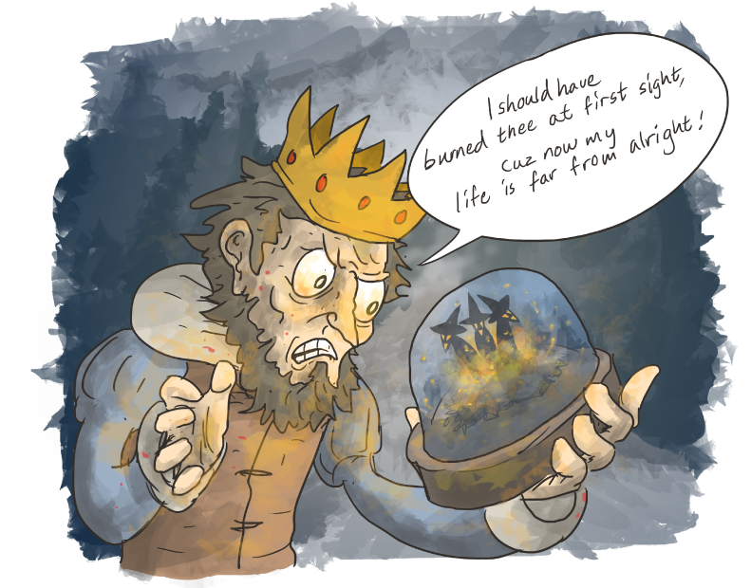
Essential Question:
Do the witches see the evil in Macbeth and bring it out of him or is Macbeth a honorable man who is tricked into evil by the witches?

Slide 14
Activity 2-
Act 1
Scenes 1-2

Slide 15
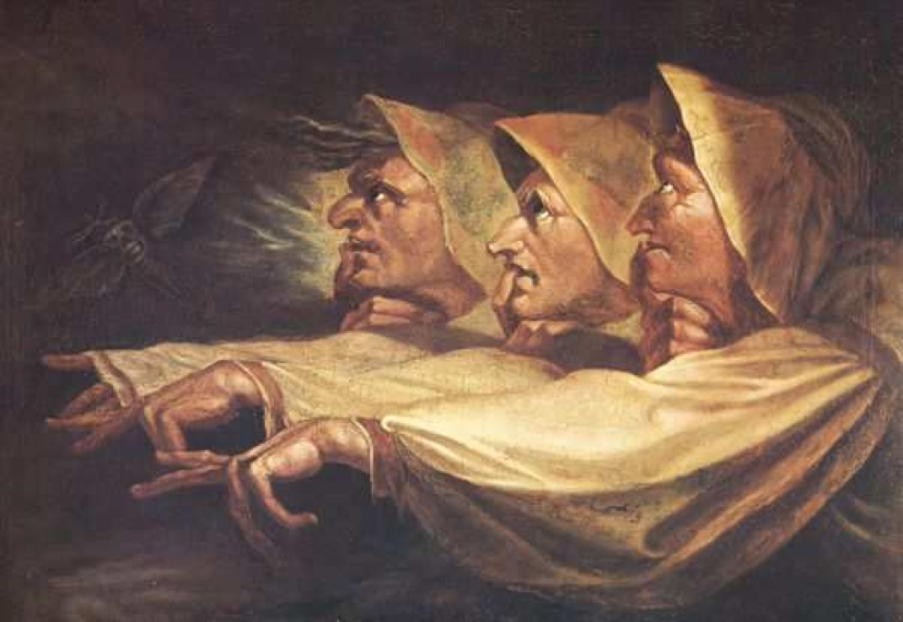
Act 1, Scene 1

Slide 16
Witchcraft in Shakespeare's Time

Slide 17
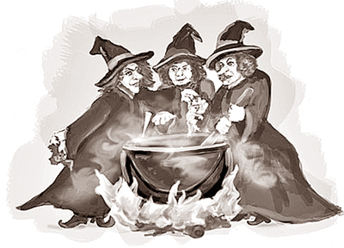
Discussion Question……
According to the video segments, how were supernatural elements - magic, ghosts, witches, etc. - viewed differently during Shakespeare’s time? How might those views have affected how the audience watched/reacted to the plays? Support your answers using evidence from the video segment.

Slide 18
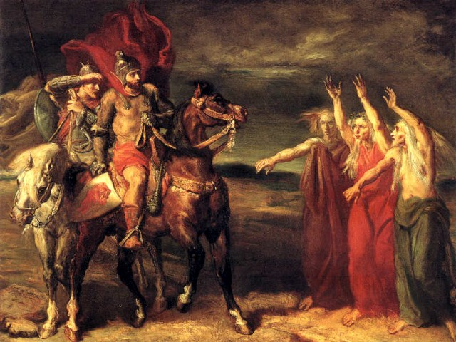
Enter the Witches

Slide 19
Act 1, Scene 1
Fair is Foul
Foul is Fair
What could the witches mean when they say this and why end the first scene with this message?

Slide 20
Translation:
If it looks good, it will be bad
If it looks bad, it will be good
Hmmm. That’s an interesting way to start a play.

Slide 21
Activity 3

Slide 22
Act 1, Scene 2

Slide 23

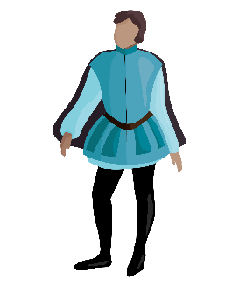
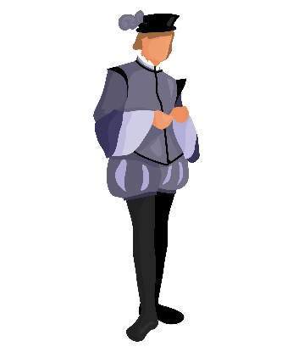
How does one become king of Scotland in 1040?
King!
Thanes, Many Thanes

Slide 24
First, What is a Thane?
A thane was a man who was granted land to govern by the king. The king could give a man more than one parcel of land and the man could be thane of two or more place. This means a man could hold more than one title.
A king could just as easily take a title of thane away from a man.
The title of thane passed down from father to son.
Any thane could become king after the king’s death. A vote among the thanes would take place and the winner would be the new king. UNLESS a king granted his son the title of Prince of Cumberland. This meant that the son would become king after his father’s death.
A thane could also challenge and kill a king in battle to become king.

Slide 25
So, when the king died the thanes held an election. The man with the most votes became king.
King!
Thanes, many Thanes

Slide 26
Act 1, Scene 2
What does the bloody captain tell King Duncan about Macbeth and Banquo?
Who was the Thane of Cawdor and what did he do?
What does King Duncan decide to give Macbeth and why?

Slide 27
Activity 4-
Quick Write

Slide 28
Quick Write
What have we learned about Macbeth from 1.2? Use direct evidence from the text.

